Slide 1
09_ThreeJS
Computer Graphics

Slide 2
Reference (Not a Textbook)
Jos Dirksen, Learn Three.js, 3rd Edition, Packt Publishing, 2018.

Slide 3
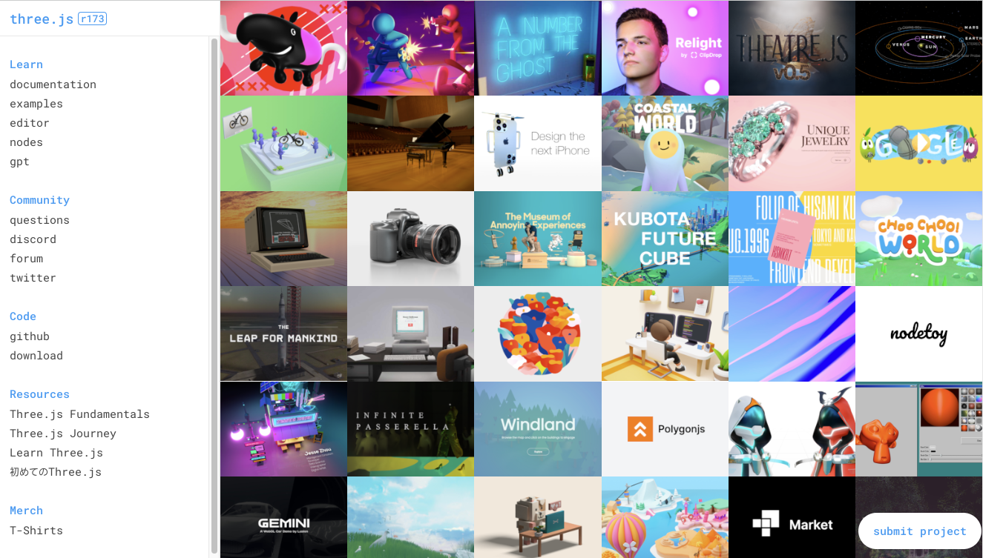
Three.js Home
https://threejs.org
Projects
Documentation
Examples
Community
Code
Resources - lectures

Slide 4
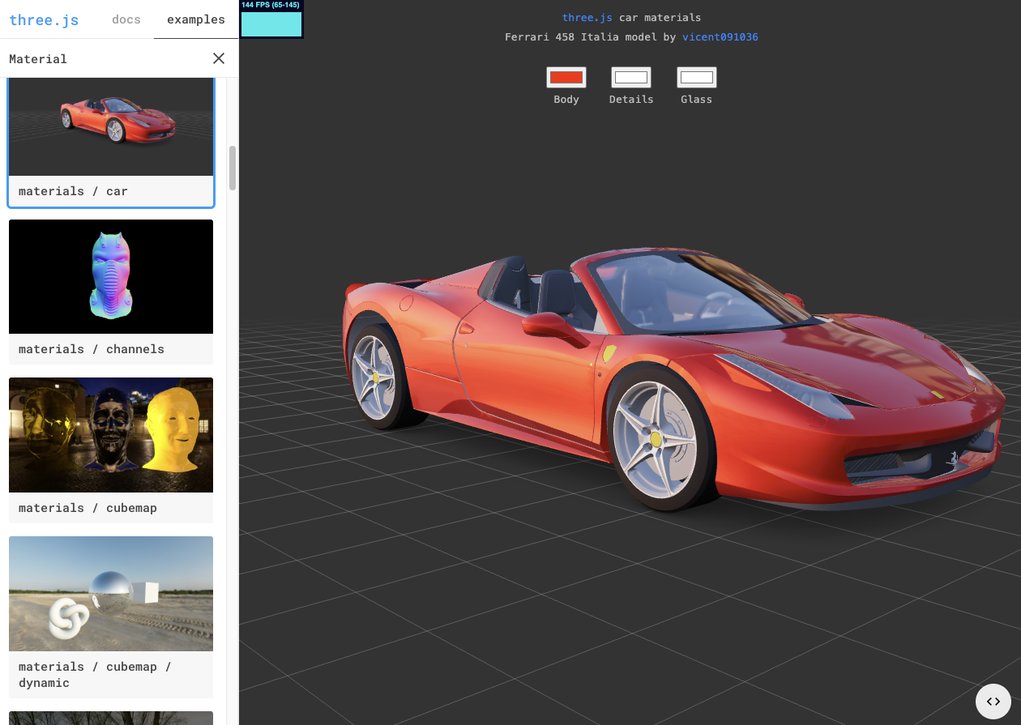
Three.js Examples
모든 example은 source code가 제공됨

Slide 5
Download the Example Code in Our Class
https://github.com/iklee99/ThreeJSSource

Slide 6
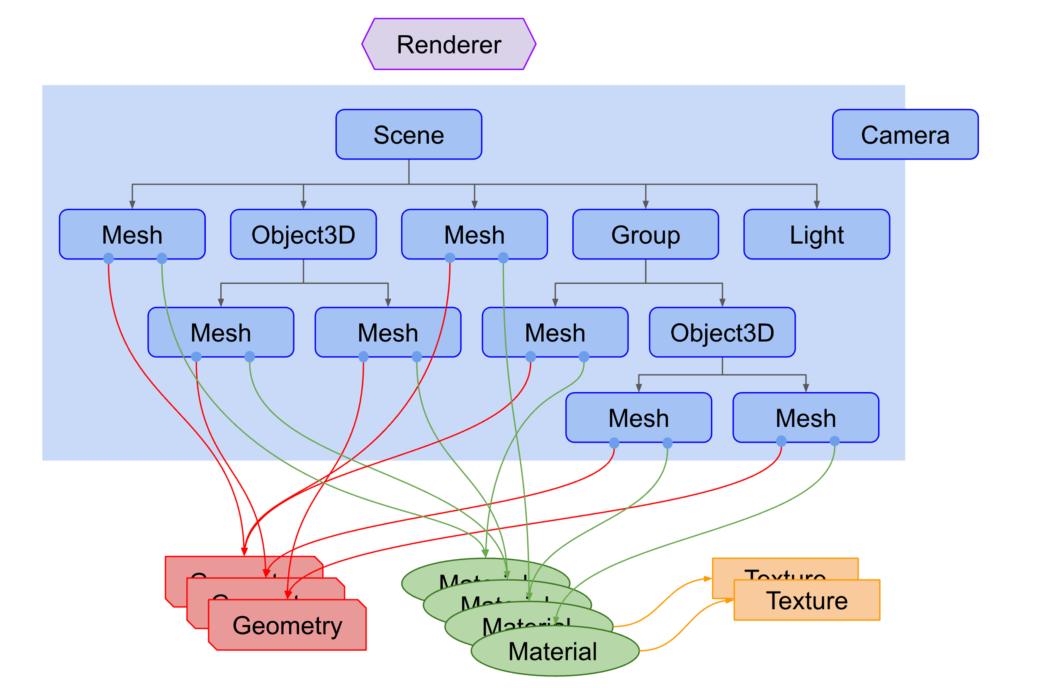
Object Hierarchy in Three.js
Mesh = Geometry + Material
Mesh, Object3D, Group, Light, Camera를 Scene에 add

Slide 7
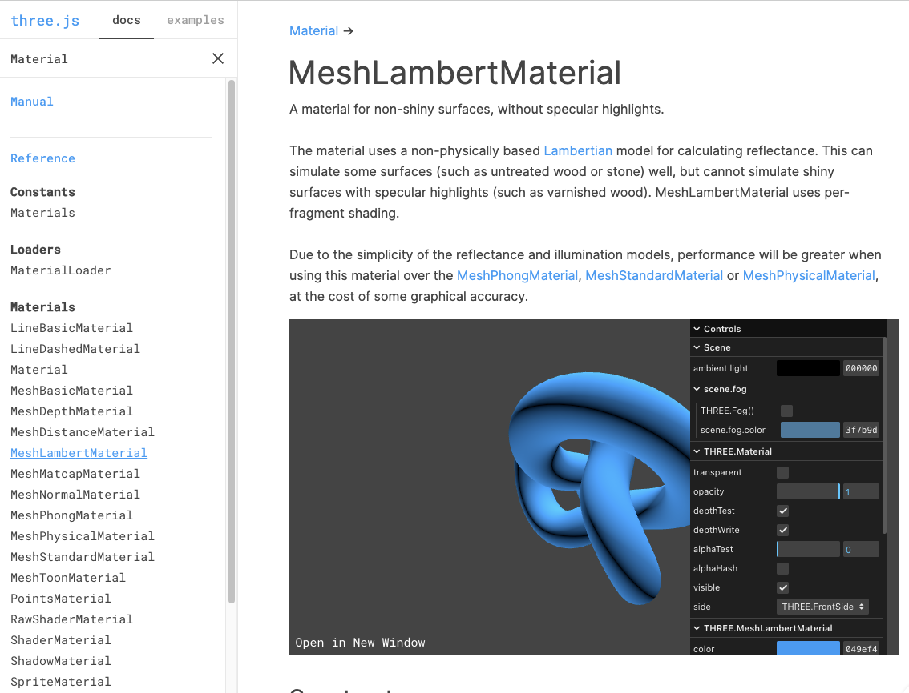
Three.js documentation
? 창에 class 이름 넣고 search
ex) “Material”
MeshPhongMaterial
diffuse + specular
MeshLambertMaterial
only diffuse
UI 이용하여 parameter 조절 해 볼 수 있음

Slide 8
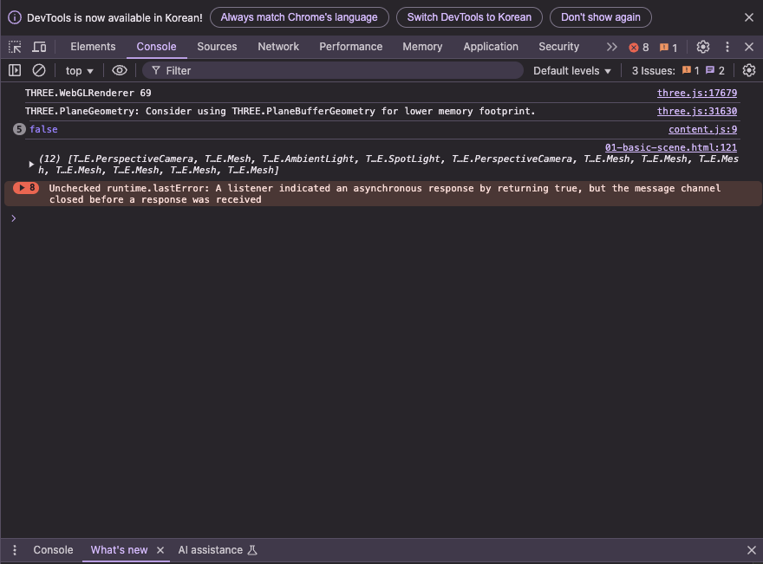
console.log(...)
Chrome의 개발자 모드 (Ctrl-Alt-i) 의 console에 value를 print
여기서는 scene의 모든 children을 print

Slide 9
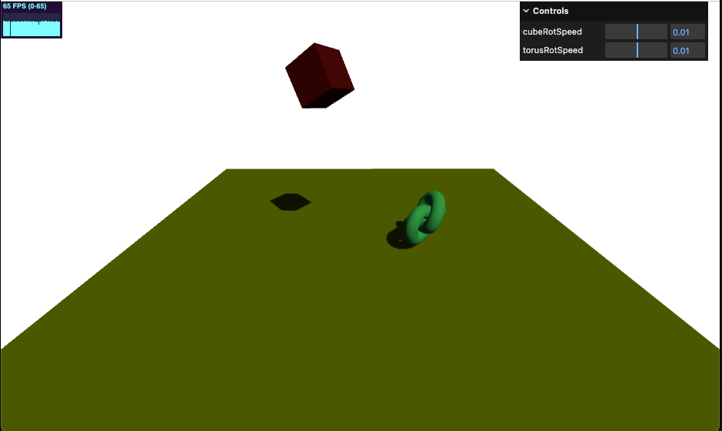
01-getting-started

Slide 10
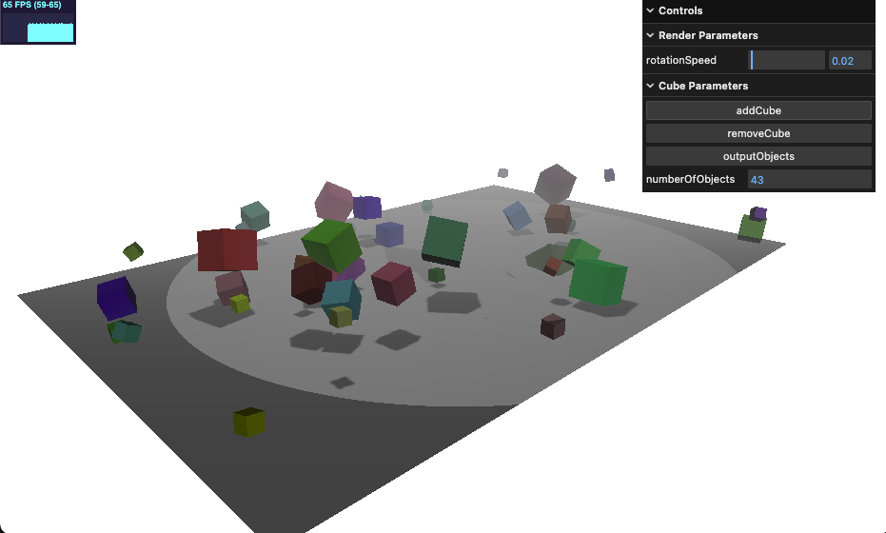
02-foggy-cubes.html
GUI
Stats
fog
scene.children

Slide 11
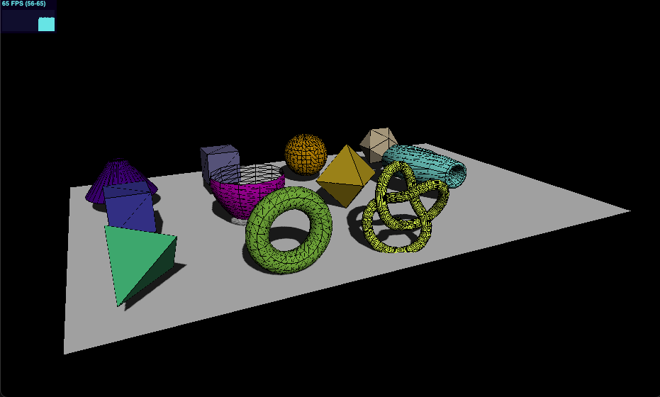
03-geometries
Geometries
Cylinder
Box
Sphere
Icosahedron
Convex
Lathe [lei♁]
Octahedron
Parametric
Tetrahedron
Torus
TorusKnot

Slide 12
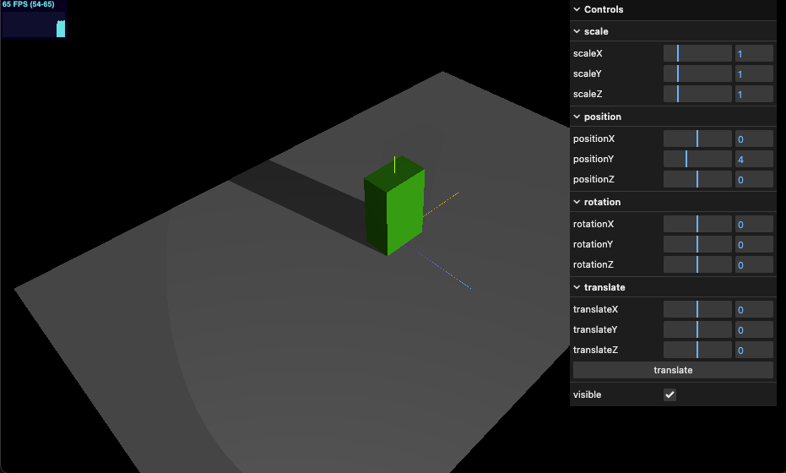
04-mesh-properties

Slide 13
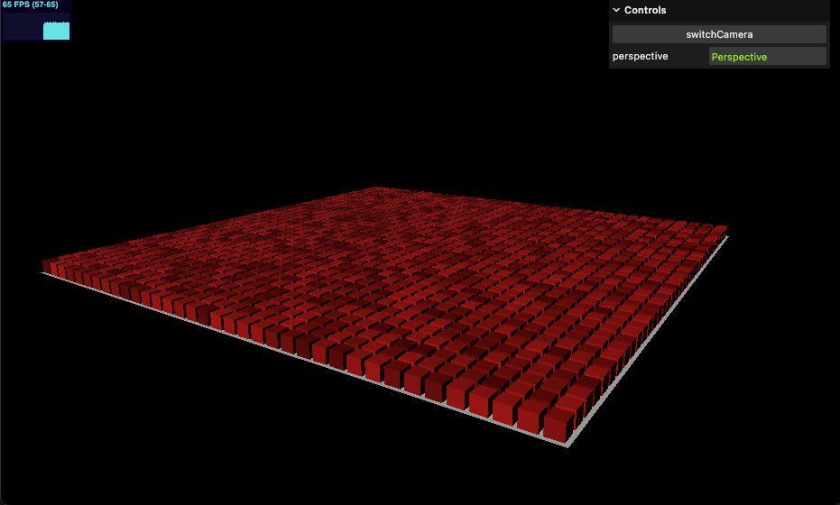
05-both-camera
Perspective vs
Orthographic Camera

Slide 14
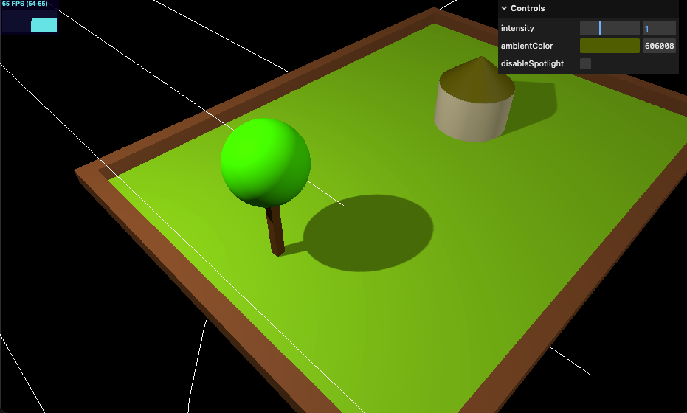
06-ambient-light

Slide 15
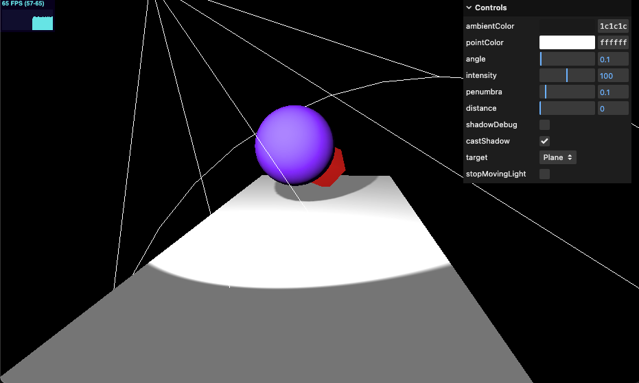
07-spot-light

Slide 16
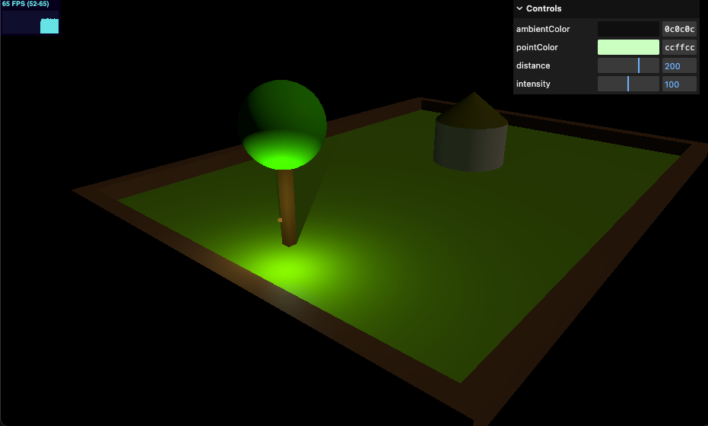
08-point-light

Slide 17
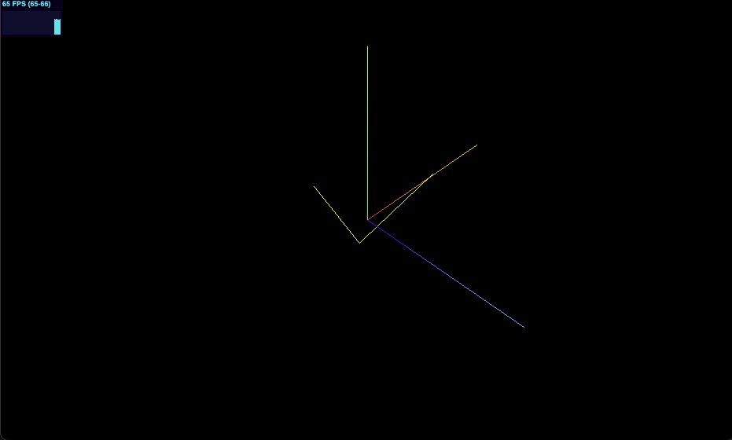
09-line-material

Slide 18
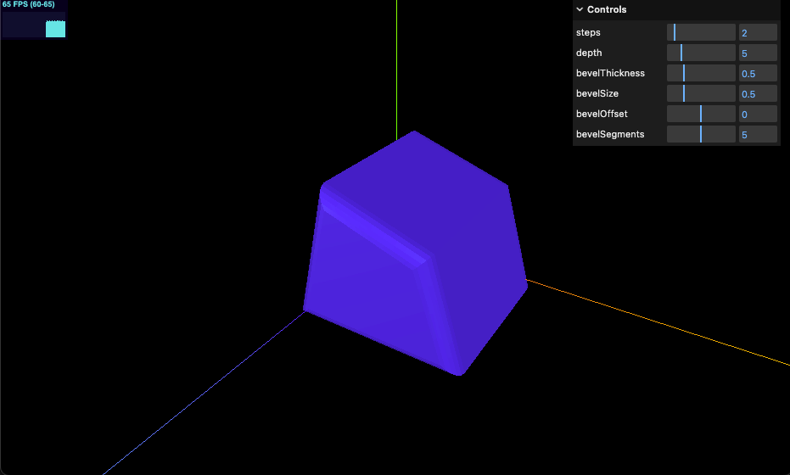
10-extrude-geometry

Slide 19
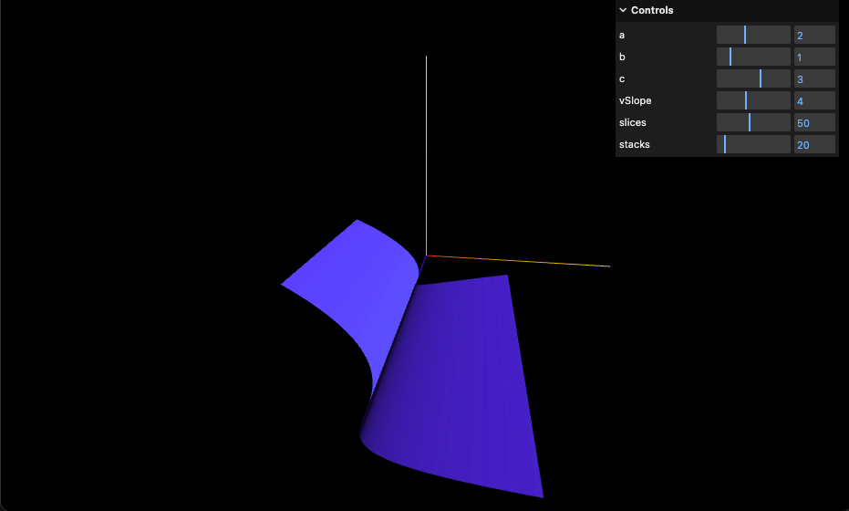
11-parametric-geometry

Slide 20
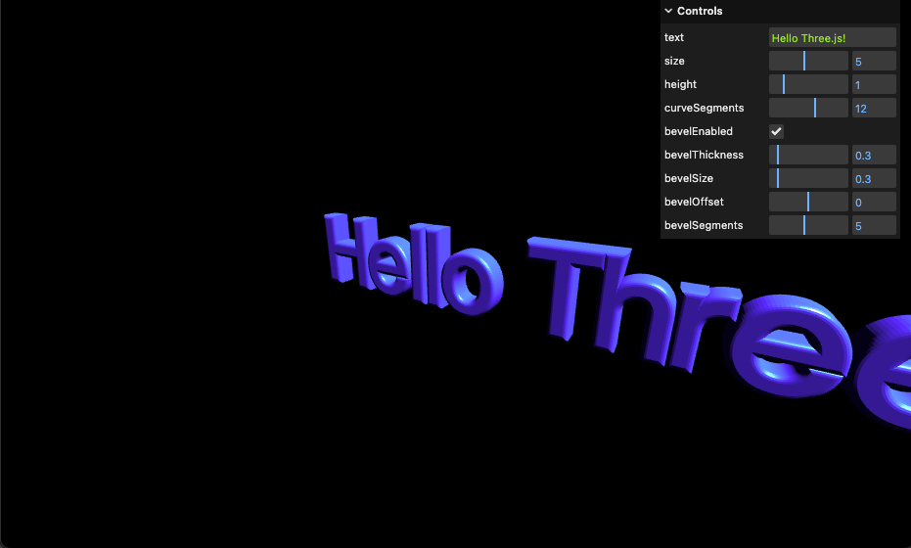
12-text-geometry

Slide 21
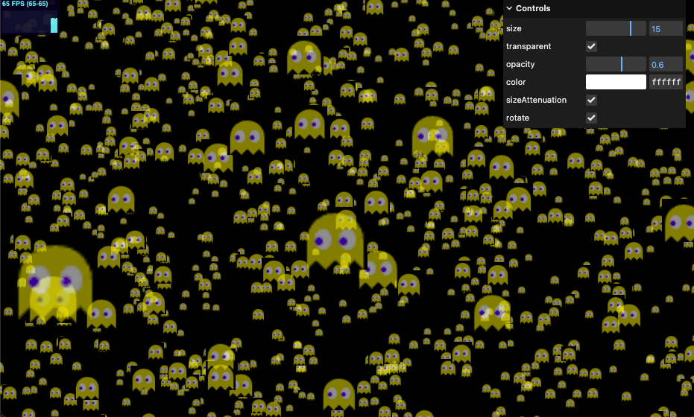
13-program-based-points

Slide 22
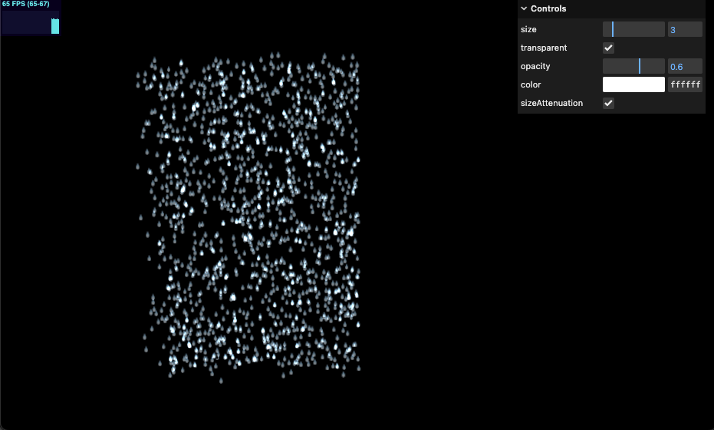
14-rainy-scene

Slide 23
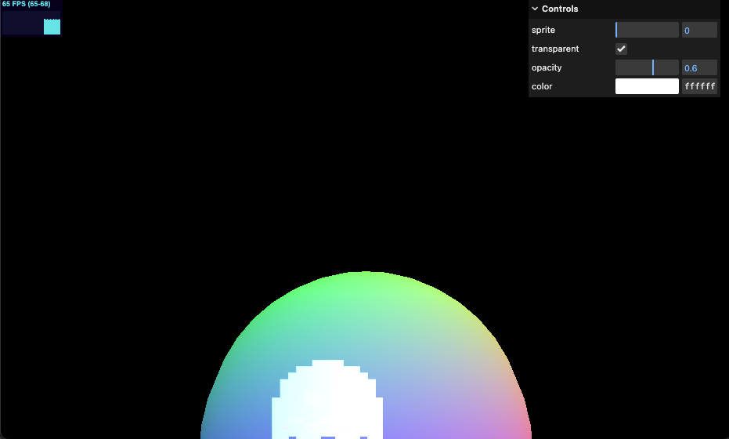
15-sprites

Slide 24
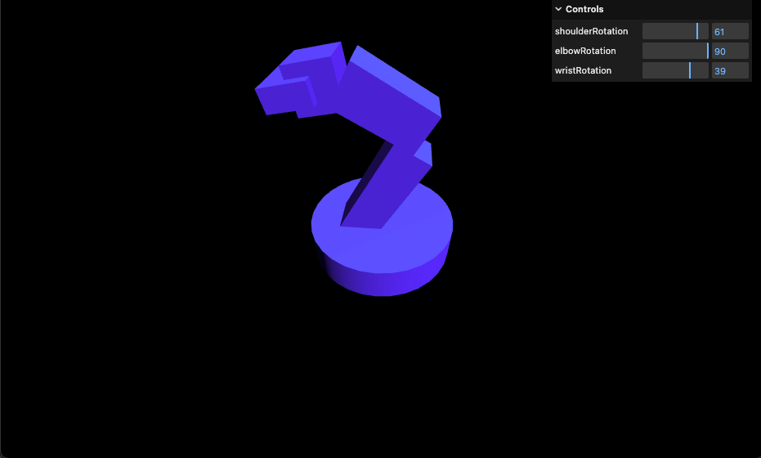
16-scene-graph

Slide 25
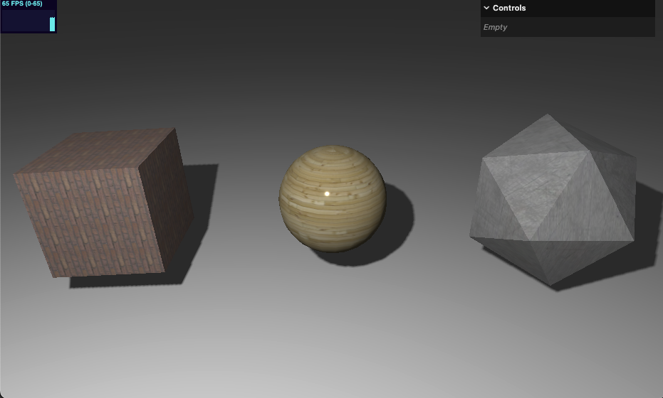
17-basic-texture

Slide 26
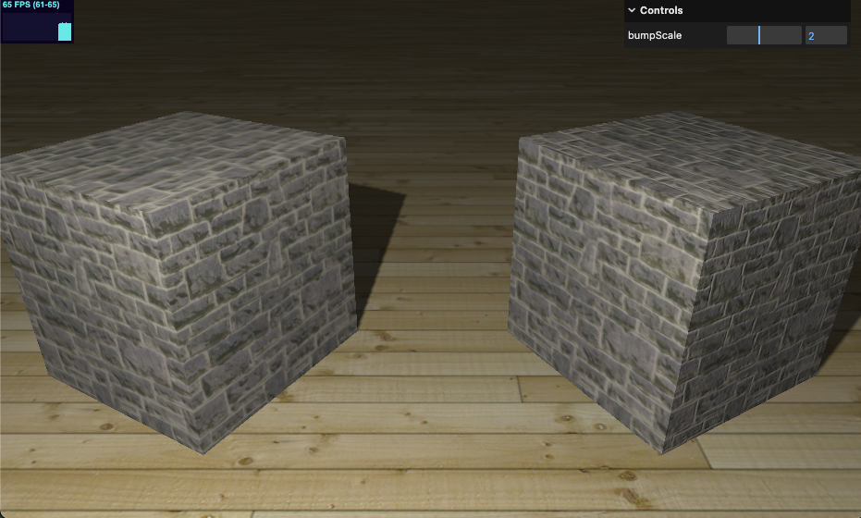
18-bump-map

Slide 27
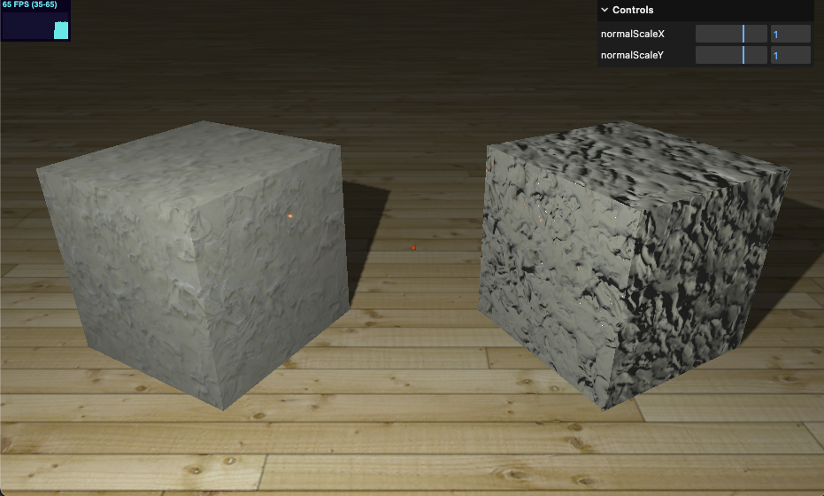
19-normal-map

Slide 28
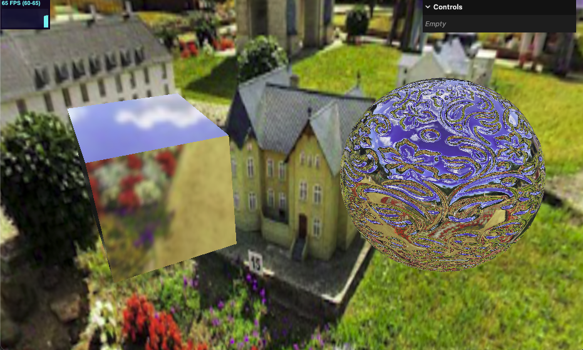
20-env-map-static

Slide 29
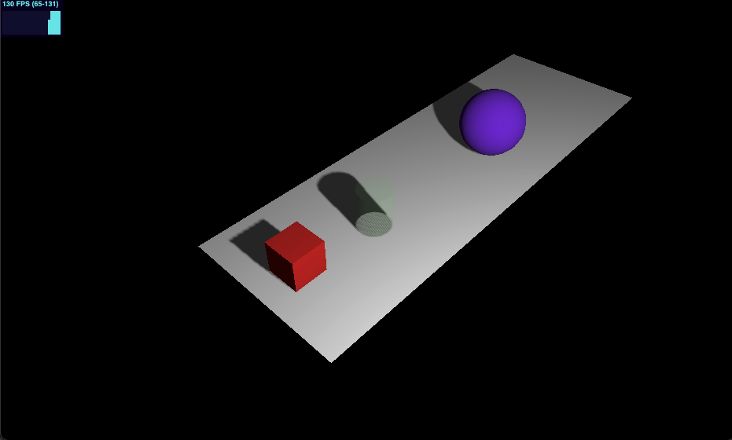
21-selecting-object

Slide 30
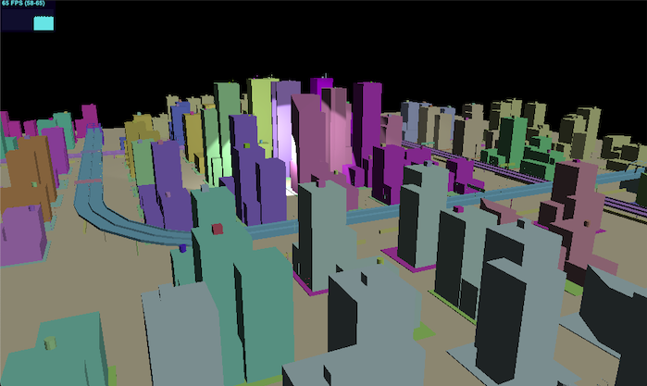
22-first-person-camera

Slide 31
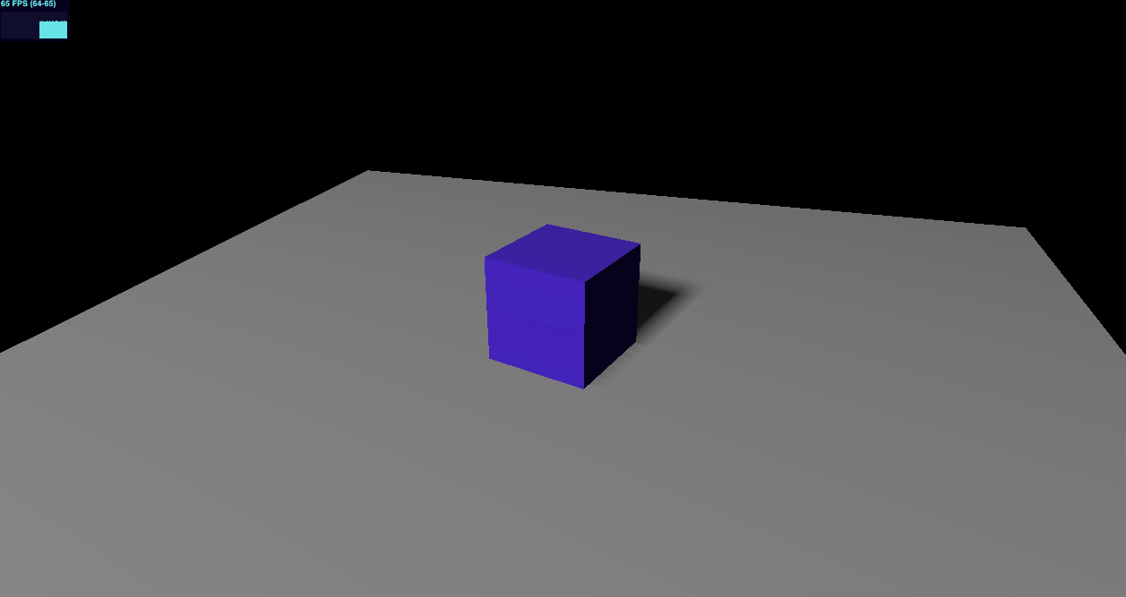
23-animation-clip

Slide 32
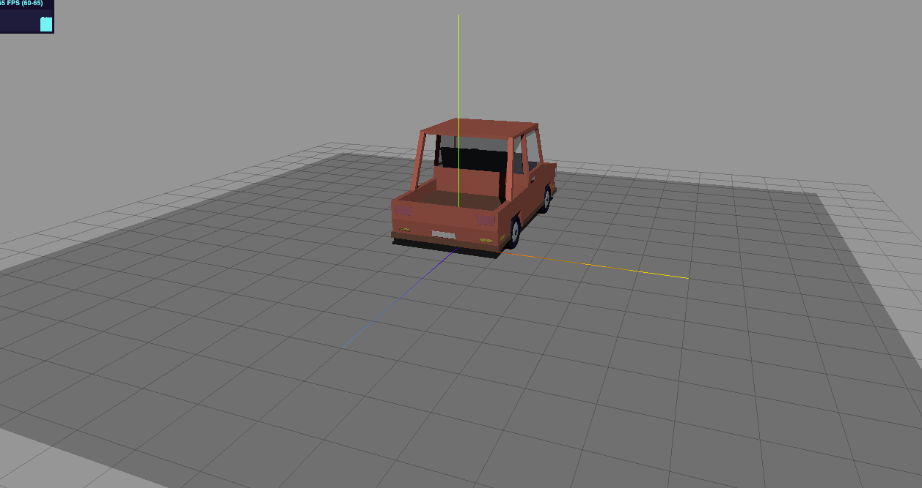
24-load-fbx-model

Slide 33
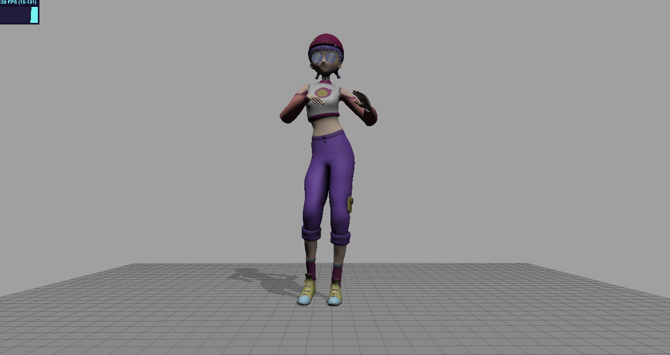
25-load-fbx-anim

Slide 34
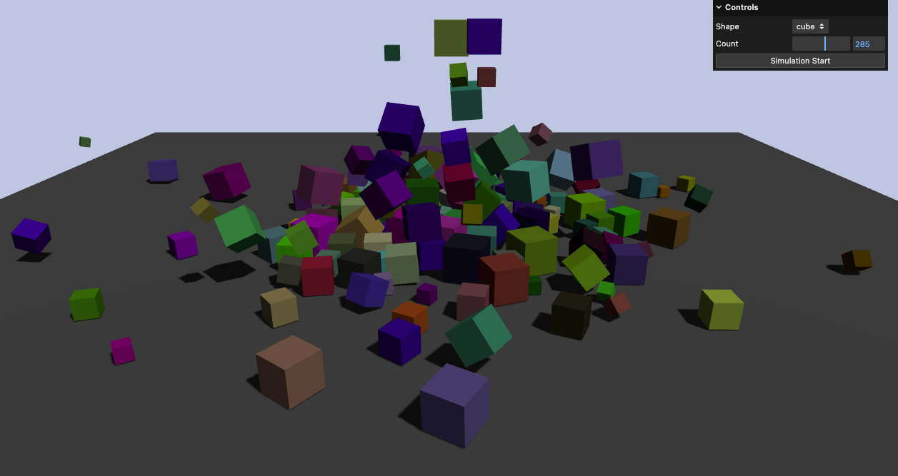
26-rapier-physics

